Slide 1
Fiscal Policy 2015
Budget minus schemes: theory + current
Economic survey ch. On Public finance
14th Finance commission report
GST

Slide 2

Who prepares Budget?
(General) Budget: Department of Economic Affairs (MCQ-2010)

Slide 3

Who prepares Survey?
Survey
Draft: Dept. of Economic Affairs
CSO inputs (Min. of Stat & Prog implementation)
Chief Economic Advisor to FM- Arvind Subramanian
Finance Secretary + FM
Theme: Creating opportunity and reducing vulnerability

Slide 4
What’s new?
Survey
Earlier 13 chapter + 1 appendix = 14 chapter
Now Two volumes inspired from IMF’s world economic outlook.
Vol1: future outlook
Vol2: past data & present situation

Slide 5
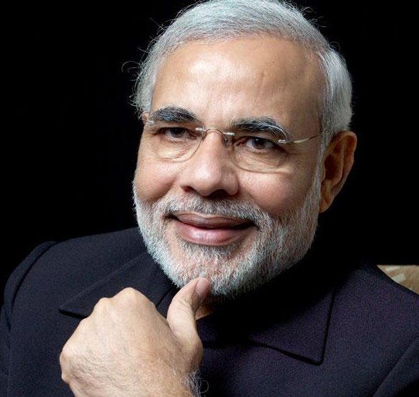
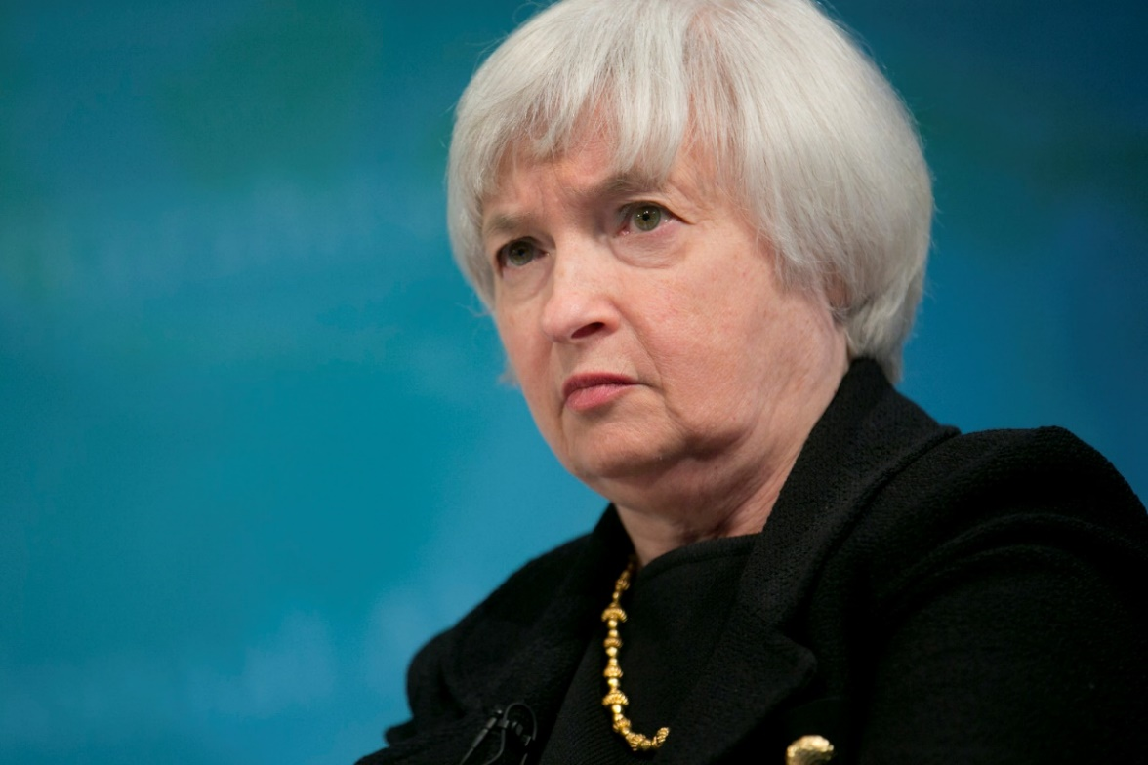
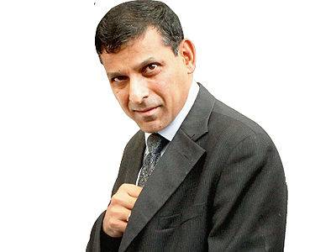
Pillar#1: NCERT-self study
2. Banking-Finance
Vol2-Ch.3
Vol1-Ch.5
3. Fiscal Policy
V2-Ch.2
V1-Ch.2
V1-Ch.10 (FC)
4. International
Vol2-Ch4
Infl.targeting
Atal pension etc.
FDI-FII….X
Gold monetization

Slide 6
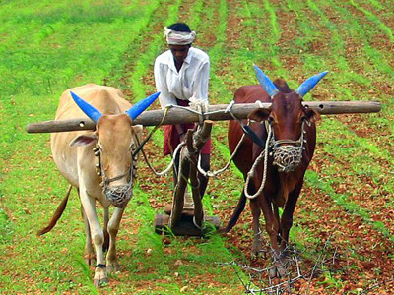

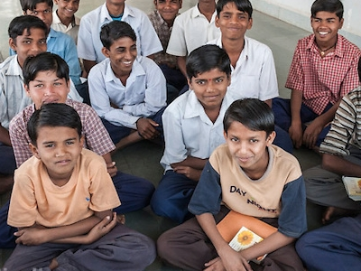
MUDRA, SETU, Atal Innov.
Amrut Mahotsav
Yoga, Vidhya Lxmi
5. Sectors of Economy
Outlook: V2-1; V1-1
Agro:V2-5, V1-8,
MFG: V1-7
Services:V2-7
6.Infrastructure
Climate: V2-8; V1-9
Infra: V2-6, V1-4,V1-6
7. HRD
V2-9
V1-3 (JAM)

Slide 7
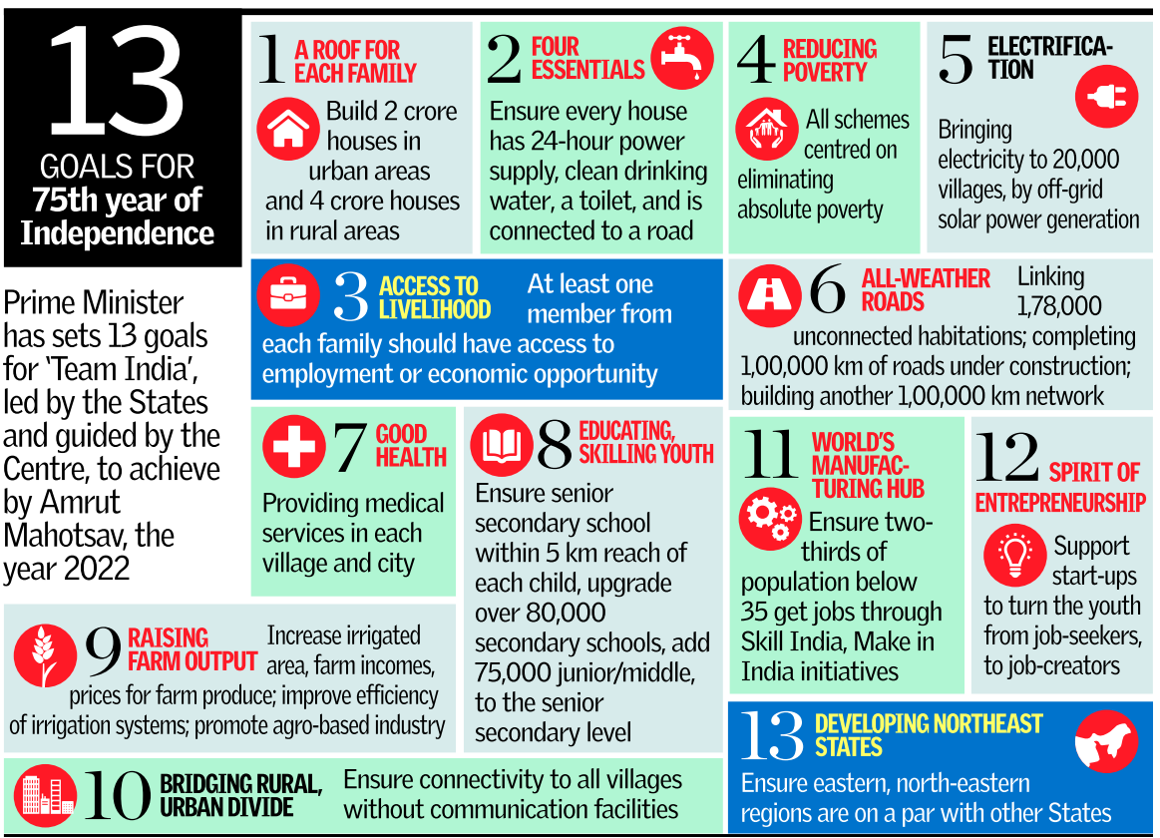
Thehindu
1st March

Slide 8
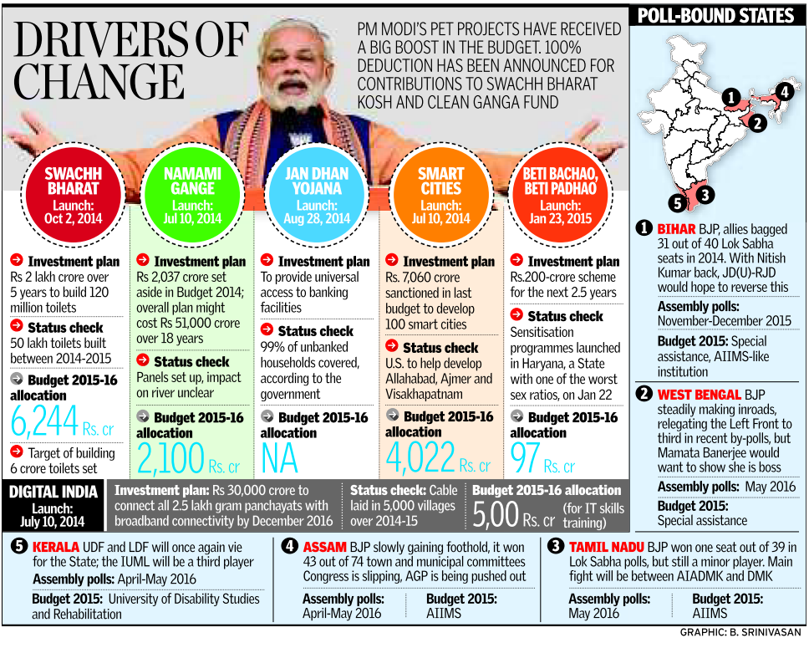
Thehindu
1st March

Slide 9
Why you should read budget speech + Survey?
Readymade notes only “supplement”.
Writer’s interpretation of what’s important & what’s not? (Sting Op)
Factual errors creep in.
Assertion reasoning- directly lifted
Mains /essay: statements / ideas lifted
Fodder for “Vague” questions
Hindi / Gujarati : terminology

Slide 10
Fiscal Policy 2015
Budget minus schemes: theory + current
Economic survey ch. on Public finance (V2c2, v1c2, v1c10)
14th Finance commission report
GST

Slide 11
Theory self-study
Budget
Parliament: budget making
Union vs State list (Taxation)
Centre-State financial relations
CAG, Finance Commission
PRI: State finance commission
….

Slide 12
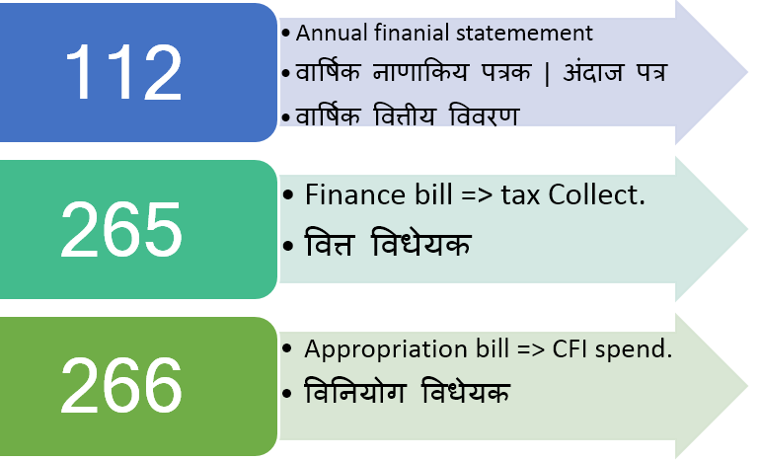
Why 3 documents?
Budget

Slide 13
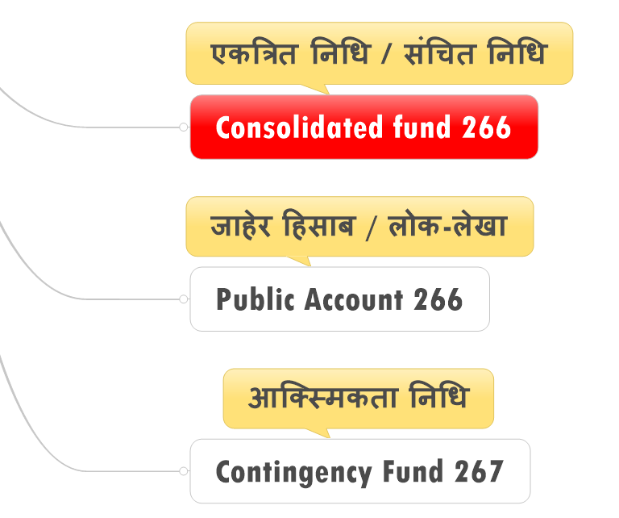
Incoming Money
Budget

Slide 14
Consolidated fund
Art. 266
Revenue collected
All the loans raised
Interest/principle received
Need approval of legislature? YES.

Slide 15
Public Account
Art. 266
National Investment fund (05)
NCCF=>merged with NDRF
National small savings fund,
Prarambhik Shiksha Kosh
MNREGA fund
State provident fund, Postal insurance, Money orders etc…
Need parliament approval? NO

Slide 16
Contingency Fund
Art.267
For unforeseen events
Under President (operate by Fin.Secy.)
Rs. 500 crores (India 2011)
Need parliament approval? NO

Slide 17
Vote on Account Interim Budget
Budget
CFI: No spending without parliament approval.
Budget introduced in Feb but passed in April.
SO…..???

Slide 18
Vote on Account
Interim Budget
Every year
Cash problem between Feb to April
Election year / extreme situation
Not moral for outgoing Government to make drastic changes

Slide 19
Vote on Account
Interim Budget
Only Expenditure permission
AFS
Finance Bill (tax)
Appro. Bill (CFI)
Vote on Account

Slide 20
Vote on Account
Interim Budget
Valid 2-4 months, till appropriation bill passed
Valid for Entire year
1st April – 31st March
But new Government can change.
Feb 14: Interim (PC)
July 14: Full (Jaitley)

Slide 21
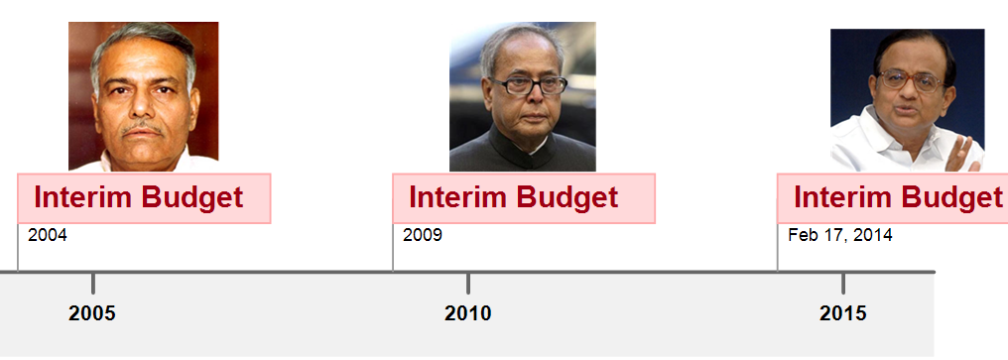
Interim budget in past- 12-18 pages

Slide 22
CSAT 2011: what’s the difference?
vote on account is used by a regular government, interim budget used by a caretaker government.
a “vote on account” only deals with the expenditure, while an “interim budget” includes both expenditure and receipts
Both A and B
Neither A nor B

Slide 23
Caretaker Government
Defintion?
Last Government continues to be in office, till new PM/CM arrives
After term has expired.
After PM/CM has resigned (AK)
No-confidence motion passed
Parliament/Assembly dissolved. (then where will you place “interim budget”?)

Slide 24
CSAT 2011: what’s the difference?
vote on account is used by a regular government, interim budget used by a caretaker government.
a “vote on account” only deals with the expenditure, while an “interim budget” includes both expenditure and receipts
Both A and B
Neither A nor B

Slide 25
Budget
3 documents in budget (AFS, Fin, APPRO)
3 Types of “Funds” (CFI, PA, Conting.)
Vote on account vs Interim budget
TWO Part of budget

Slide 26
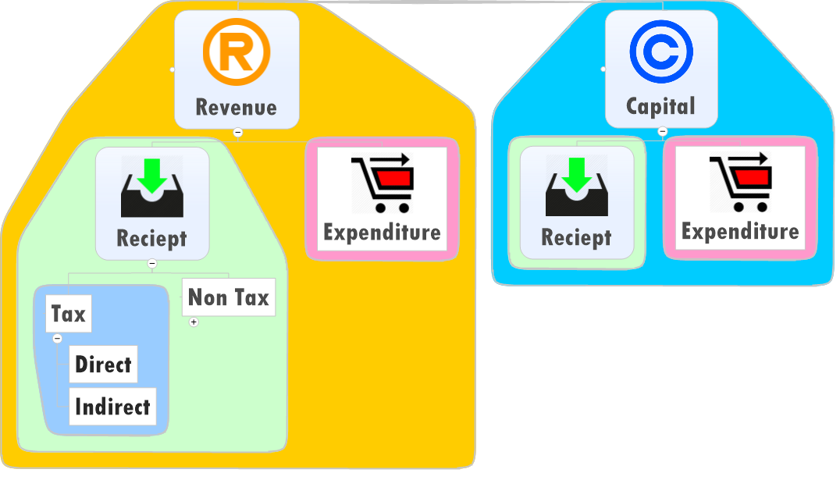
Parts of budget

Slide 27
Parts of budget

Slide 28
Parts of budget

Slide 29
Direct Taxes UNION
TAX
Type#1: income / Expenditure
Income tax
Corporate Tax (and MAT)
Interest tax (on banks)
Hotel receipt Tax
FBT (Pranab)

Slide 30
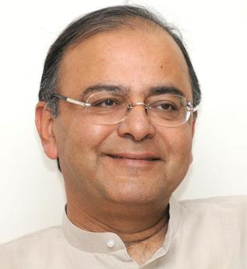


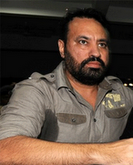
Service tax: indirect Tax on Expenditure
Indirect Tax

Slide 31
Fringe Benefit tax: Tax on Expenditure
Direct Tax

Slide 32
Direct Taxes UNION
TAX
Type#1: income / Expenditure
Income tax
Corporate Tax (and MAT)
Interest tax (on banks)
Hotel receipt Tax
FBT (Pranab)
Direct taxes levied only on income and property….WRONG

Slide 33
Direct Taxes UNION
TAX
Type#2: Property, Assets, Capital Transaction
Securities transaction Tax (STT)
Capital Gains Tax (profit on asset sale)
Wealth Tax (Jaitley)
Banking cash transaction tax
Estate duty (VP singh)
Gift tax (Yashwant)

Slide 34
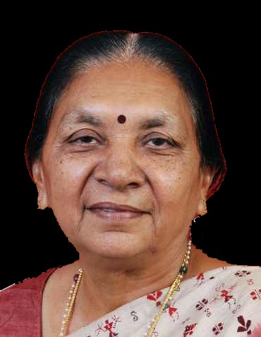
Direct Tax States
Taxation
Type#1: Taxes on income
Agriculture income tax
Professional tax (Max 2500. 14th says raise to 12k)
Type#2: Taxes on properties
Land Revenue
Stamp duty/registration duty
Property tax in urban areas

Slide 35
Direct taxes
Union vs states
Pros and cons

Slide 36

pros
Direct tax
Progressive (richer person higher tax)
Inequality of income …reduced
Certainty (when and how)
Elasticity, quick results when raised / lowered.

Slide 37

Demerits
Direct tax
Collection expensive (staff salary, database Management).
Therefore, Narrow base.
Externality not counted: Tata vs filmstar
Hardship not counted: Carpenter vs landlord.

Slide 38
Demerits
Direct Tax
High level of direct taxes=>
less tendency to work;
less foreign investment / foreign workers
To encourage Savings & investment: tax deduction- exemptions given=> litigation, avoidance using loopholes

Slide 39
Direct taxes
Union vs states
Pros and cons
Budget 2015 provisions

Slide 40
Income Tax slabs in Budget 2015 unchanged
 | ordinary | 60 age | 80 Age
10% | >2.5 to 5 | >3 to 5 | None
20% | >5 to 10 | Same | Same
30% | >10 | Same | Same
3% education cess (All)
+ 12% surcharge (1 crore: company or individual)

Slide 41
Cess vs Surcharge: difference?
Gross Income
Deduction, Exemption

Slide 42
Tax benefits : to encourage savings, social security
Type | Before | after
Health insurance | 15k | 25k
Senior citizen | 20k | 30k
S.citizen w/o health insu. |  | 30k for treatment
PH | -- | 25k
NPS | 1L | 1.5L
Transport allowance | 800pm | 1600pm
Sukanya Samriddhi payment |  | Beneficiary has to pay no tax
Varishta Bima Yojana |  | No service tax
Senior citizen- specific disease treatment |  | 80k

Slide 43
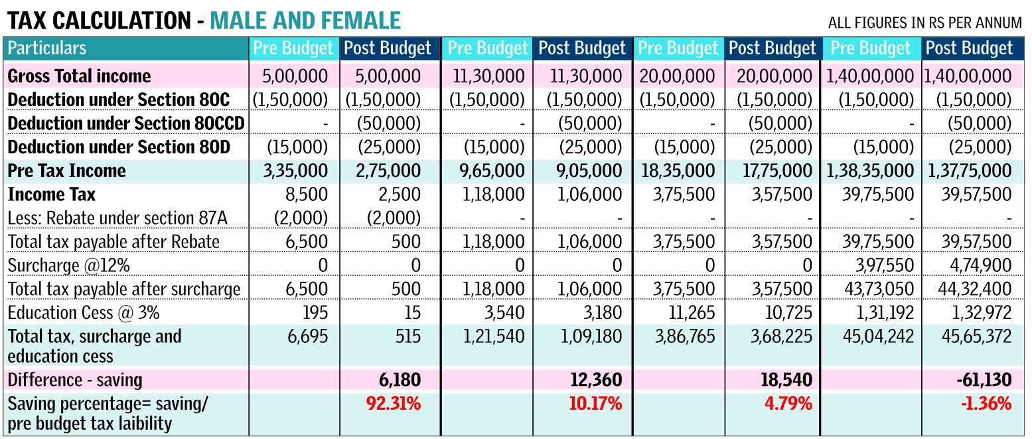
TheHindu 1st March,2014

Slide 44
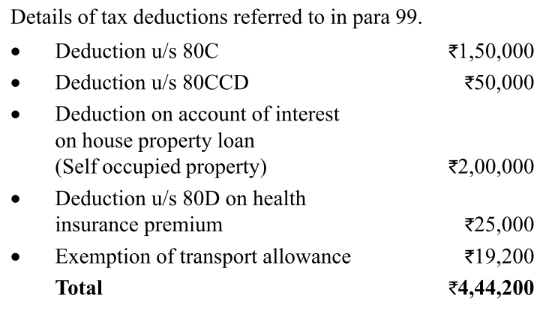
Absolute Numbers Not important for UPSC

Slide 45
100% deduction on donations
Swatch Bharat Kosh (FinMin)
Clean Ganga Fund (FM Trust)
National Fund for control of Drug Abuse (FinMin)

Slide 46
Cess Surcharge
Gross Income
Deduction, Exemption
Taxable income
(10, 20, 30) slabs
Surcharge
Cess

Slide 47
Surcharge
Cess
individual tax: 1 lakh
12% surcharge
1.12 lakh tax to be paid
(Tax + surcharge)
2% edu + 1% secondary & higher education cess
2+1=3% Edu. cess
3% x 1.12 lakh
3360 Cess
Total 100000+12000+3360= 1,15,360

Slide 48
Surcharge
Cess
Not for any specific purpose
271: Goes to Consolidated Fund India (CFI)
FC can’t share it with states
Specific purpose
Education cess 2%
Secondary- Higher edu 1%
Prarambhik Shiksha Kosh
SSA, Mid day meal
Public account
FC can’t share it with states

Slide 49
Direct Taxes in Budget 2015
Corporate tax (Desi) | 30% (▼to 25% in 4 yrs)
Corporate tax (foreign) | 40%
MAT | 18.5% on book profits
STT | 0.001%-0.25%
Foreigner’s income from Indian debt instruments | 5% (upto 2017)
Royalties/ Tech.Service | 25% => 10%
Wealth tax (>30 lakh) | 1%
Notes:
The basic rate of
Corporate Tax in India at 30% is higher than the rates prevalent in the other
major Asian economies, making our domestic industry uncompetitive. Moreover,
the effective collection of Corporate Tax is about 23%.

Slide 50

Why removed
Wealth tax
1% tax on Wealth above 30 lakh.
Immovable Property, vehicles, jewelery etc.
For individual, companies and HUF
Hardly 1008 crore earned (2013-14)
Cost of collection high.
Evasion high, black money generation
Abolished wealth tax

Slide 51
Good tax system
Many principles, Adam Smith 4 canon for MCQ
Canon of Equality: Proportionate to income.
Canon of Certainty: about deadline and rates.
Canon of Convenience: to the tax payer.
Canon of Economy: collection cost should be minimum. (i.e. staff salary, DBM)
Extra:
- transparency, simplicity, elasticity (to economic fluctuation) etc.

Slide 52

Replaced with Surcharge
Wealth tax
Individual, HUF, Firms, Cooperative societies, Local authorities
If taxable income >above 1 crore
12% surcharge=> 9k crore more than before. (1008 lost)
Have mention wealth/assets in IT-returns though.

Slide 53
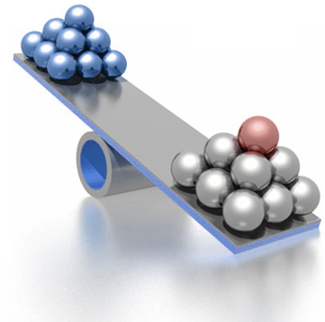
Effective Tax rate?
Super rich
taxable income >1 crore
Income tax 30%
Surcharge 12%
30% + 12%(30%)
(30 x 1.12)
3% cess on that
1.03 x (30 x 1.12)
=34.61% effective tax rate

Slide 54
Surcharge on corporates (not much important)
Income | Desi Co. | Foreign
>1 to 10crore | 7% | 2%
>10crore | 12% | 5%

Slide 55
Budget-direct tax theory
Direct tax 2015
DTC not implemented…WHY? (in next part on black money, GAAR)
Collection Rates

Slide 56
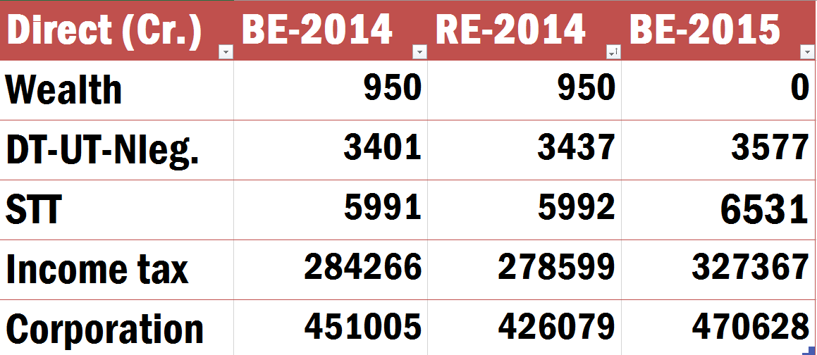
Direct tax numbers (increasing order)

Slide 57
Direct tax numbers (increasing order)
more
Shortfall
Shortfall

Slide 58
Direct tax numbers (increasing order)

Slide 59
Budget Revenue => Receipt => Indirect taxes

Slide 60
indirect Taxes UNION
TAX
Custom Duty (Import, Export)
Excise Duty (CENVAT system)
Service Tax
CST (but entirely given to States)

Slide 61
indirect Tax States
Taxation
Sales tax/VAT (newspaper…X)
Excise on liquor, narcotics
Motor vehicle tax, animal,boats, Tolls
Luxury tax, betting-gambling
Entertainment, Electricity tax
Advertisement tax (TV/radio/Newspaper..X)

Slide 62
Indirect Tax
Merits
Convenient. no additional paperwork for the customer.
Wider base. Everyone covered.
Less evasion, especially under VAT/GST. (invoice credit)
Elastic. Small increase brings large revenue
Checks on harmful consumption: cigar, alcohol, even GOLD.

Slide 63
Indirect Tax
Demerits
Single point taxes=high level of corruption, evasion, cascading effect. E.g. sales tax. (Although not in GST/VAT)
Regressive in nature
Both poor and rich taxed equally for the same item
poor people end up paying more portion of their income in indirect taxes.

Slide 64
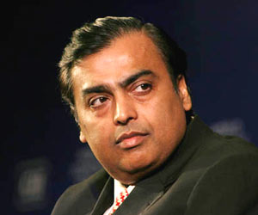
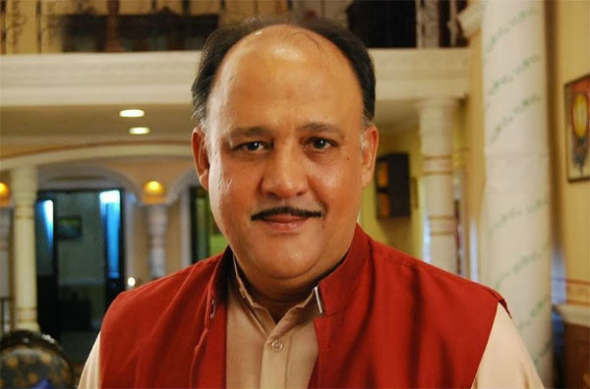

Regressive: Rs. 1000 Milk, Rs.100 Tax
0.0000000..1%
0.2%
1%

Slide 65
Taxation
Union vs States: Examples
Merits and Demerits
GST 1/4/2016..separate PPT
Service tax theory
Then…Budget 2015 provisions

Slide 66
Service tax: theory
Custom act…yes
Excise act…yes
Service tax…no (only a chapter in Finance Act)…1994
Article 268-A empowers union (88th 2003)
J&K…..No
Service provider <10 lakh…..No
TDS….No

Slide 67
Negative List
Exempted
Service tax doesn’t apply to these services
To change this list, have to amend finance Act
By Government notification
Budget 2015: Varishta Pension Bima Yojana…exempted

Slide 68

Negative list
Service tax:
Total 17 categories
Basic post office (except speed post, express parcel)
RBI services
Foreign Diplomatic services in India
Road Transport (except Rail : 1st class/AC)
Renting home for residence

Slide 69
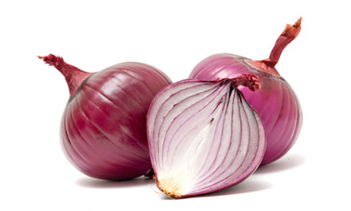
Negative list
Service tax
Agriculture related (labor, primary processing)
Sericulture, pisciculture
Education services (but not tuition)
Vocational training
Bank loan, Deposits
Funeral services

Slide 70
Negative list Jaitley pruning
Service tax:
17 categories
Jaitley wants to ‘prune’, to increase tax base
Cat1: Government services
So Government / local body services to businessman – will attract service tax.

Slide 71
Negative list Pruning
Service tax:
Cat9: Betting, gambling, lottery (lottery to be removed)

Slide 72
Negative list Pruning
Service tax:
Cat10: Amusement park
Will charge rides, bowling alleys, amusement arcades, water parks, theme parks, etc.
Will charge: Concerts, non-recognized sporting events, pageants, music concerts and award functions- if ticket price >500 Rs.

Slide 73
Negative List
Exempted
Service tax doesn’t apply to these services
To change this list, have to amend finance Act
Budget-2015 Pruning began
G2B, Lottery, Amusement
**WAIT for article
By Government notification
Don’t need parliament approval to change

Slide 74
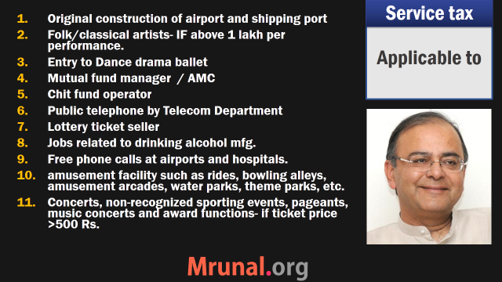
Wait for the article

Slide 75
Negative List
Exempted
Need parliament permission
By Government notification
Don’t need parliament approval to change

Slide 76
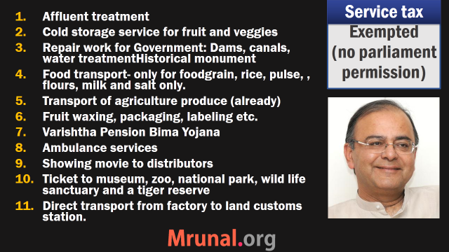
Wait for the article

Slide 77
Customs (GK type not much important for UPSC)
Increase | Decreased (Raw Material used in following)
Metallurgical coke Commercial vehicles (from 10 to 40%), But not for completely knockdown kits (10%) hybrid vehicles, electric cars | Metal parts in insulators Parts of hybrid vehicles (continued) Magnetron in microwave ovens Anthraquinone used in mfg. of hydrogen peroxide. Zeolite for washcoats Sulphuric acid for fertilizers. Digital video camera Liquified butane Antiomony metal,Ilmenite, Metal scrap etc. flexible medical video endoscopes, telecom fibers, Organic LED (OLED), LEDs, Tablet computer parts Solar water panel, LED parts Pacemaker parts

Slide 78
Excise (GK type not much imp for UPSC)
increase | decrease
Polythene bags Cigarettes & tobacco products (But not bidi) | Leather Footware >1000 (12% to 6%) Parts of hybrid vehicles solar PV, pacemaker parts Table computer, wind-power generators, solar water heater, solar PV Integrated circuit wafer in smart cards Aggarbattis interim compounds Ambulance chasis

Slide 79
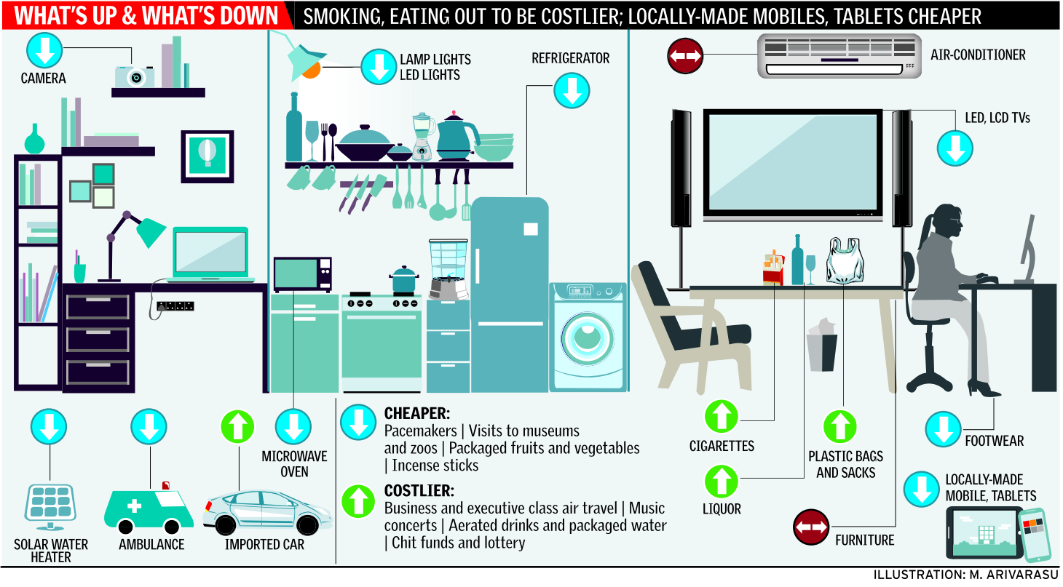
Thehindu 1st March 2015

Slide 80

Custom Excise service
Ease of doing
Custom duty reduced: make in India
Central excise / service tax registration : online and within 2 days.
Indirect Tax payers can use digitally signed invoices and e-records = less paperwork and red tapes.
CENVAT credit limit 6 months => 1 years (further: GST PPT)

Slide 81
Education Cess removed
Ease of doing
Cess | Education (2%) | Sec. & High edu. (1%)
Customs (not in GST) | Yes (imports) | yes (imports)

Slide 82
Education Cess removed
Ease of doing
Cess | Education (2%) | Sec. & High edu. (1%)
Customs (not in GST) | Yes (imports) | yes (imports)
Central Excise ▲ 12.5% | No | No
Road Cess on Petro-diesel..yes
If need 2% Swatch Bharat Cess on Services

Slide 83
Education Cess removed
Ease of doing
Cess | Education (2%) | Sec. & High edu. (1%)
Customs (not in GST) | Yes (imports) | yes (imports)
Central Excise ▲ 12.5% | No | No
Service tax ▲14% | No | No.
If need 2% Swatch Bharat Cess on Services
Smoother GST

Slide 84
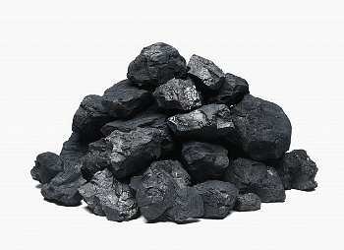
coal
cess
Clean energy cess
Both desi and imported
Increased from Rs.100 to 200 per tonne
Funds will go to Clean environment projects

Slide 85
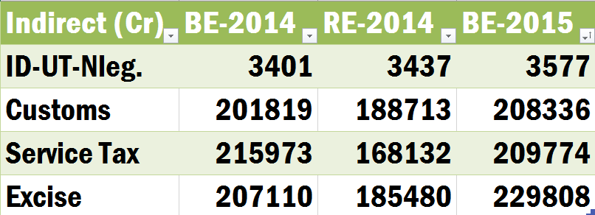
ID: Increasing order (BE-2015), shortfall..yes

Slide 86
Direct indirect
Types, Theory, pros-cons
Budget-2015 provisions
NEXT: RANKING

Slide 87
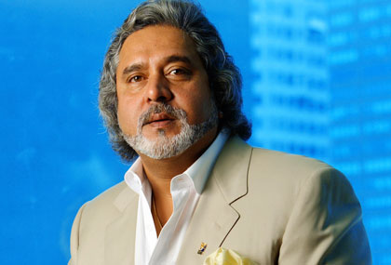

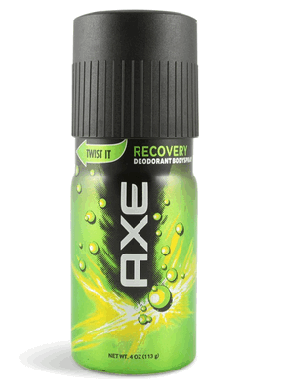


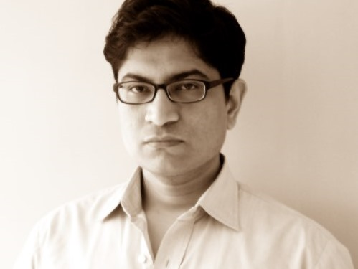
Direct
Indirect
Corp.
Wealth
Custom
Excise
Excise
STT
Service
IT

Slide 88
RE 2014 (descending order)
Direct
Taxes
Corp.
IT
STT
Wealth
Indirect
Taxes
Custom
Service
Excise

Slide 89
BE 2015 (descending order)
Direct
Taxes
Corp.
IT
STT
Wealth
Indirect
Taxes
Service
14%
Custom
Excise

Slide 90

RE 2014 (descending order)
Corp.
IT
Custom
Revenue Shortfall
Est: 13.6 L Cr.
Revised: 12.5 LCr.
Shortfall: 1.10 L cr
Excise
Service
STT
Wealth
Notes:
Revenue shortfall: R<E

Slide 91
BE 2015 (descending order)
Corp.
IT
Excise
Service
Custom
STT
Wealth
Notes:
Revenue shortfall: R<E

Slide 92
Gross vs Net Tax Revenue

Slide 93
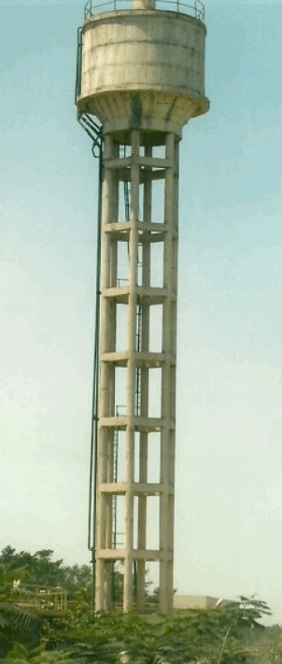
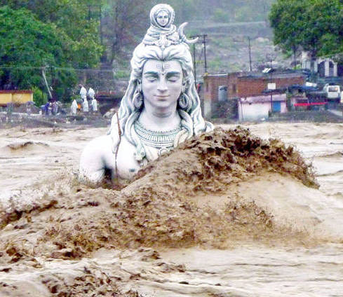
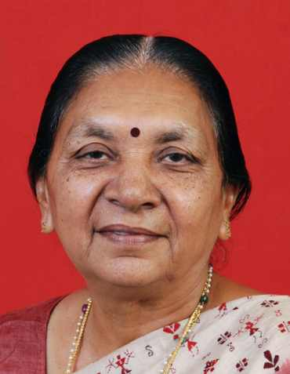
Gross Tax Revenue एकंदर महेसुल आवक
Direct
Taxes
Indirect
Taxes
UT w/o
Legislature
MINUS
NCCF
FC
NET Tax Revenue
चोख्खी महेसुल आवक
Notes:
Ekandar mehsul awak
Sakal rajaswa aay
Less - NCCD transferred to the National Calamity Contigency Fund/National Disaster Response Fund

Slide 94
NCCF / NDRF
National Calamity Contingency Fund
Merged with N.D.Response.Fund
Home ministry
Public account (parliament approval …x)
Notes:
Can Government transfer money from consolidated fund to contingency fund?
NCCF not in contingency fund.

Slide 95
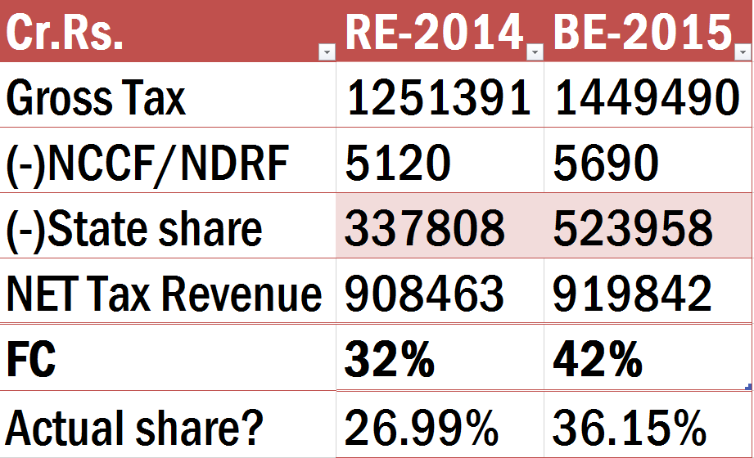
Gross: direct+indirect+ UT with no Legislature

Slide 96
Gross minus DISASTER fund

Slide 97
Gross minus DISASTER fund minus STATE SHARE
13th FC: 32%
14th FC: 42%

Slide 98
Gross vs. NET

Slide 99
Next

Slide 100
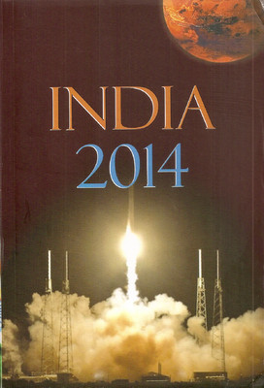
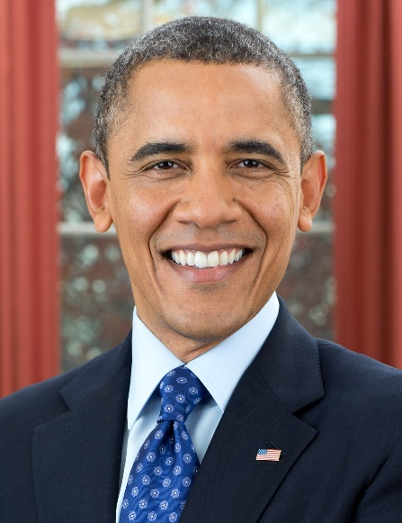



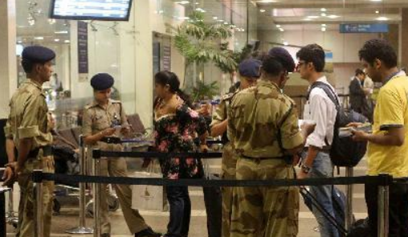

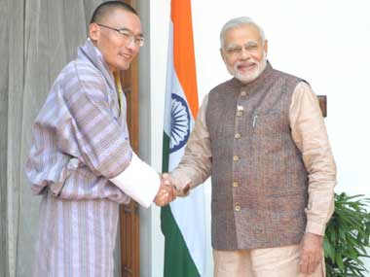
Non Tax Revenue
Investment
Interest
Dividend
Service Income
Grants
UT w/o
Legislature

Slide 101
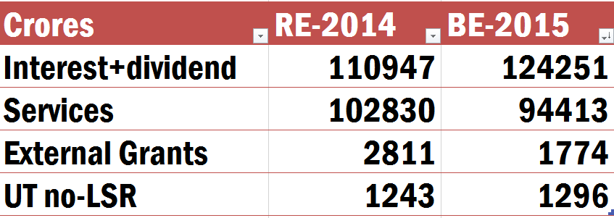
Non-Tax Revenue Decreasing order

Slide 102
Next

Slide 103
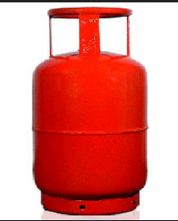
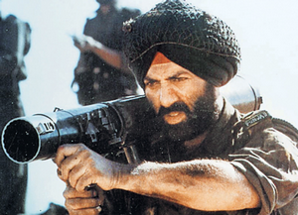

RE-2014: Revenue Expenditure (મહેસુલ ખર્ચ)
Grants
Police
Notes:
grants

Slide 104
BE-2015: Revenue Expenditure (મહેસુલ ખર્ચ)
Grants
Police
Notes:
grants

Slide 105
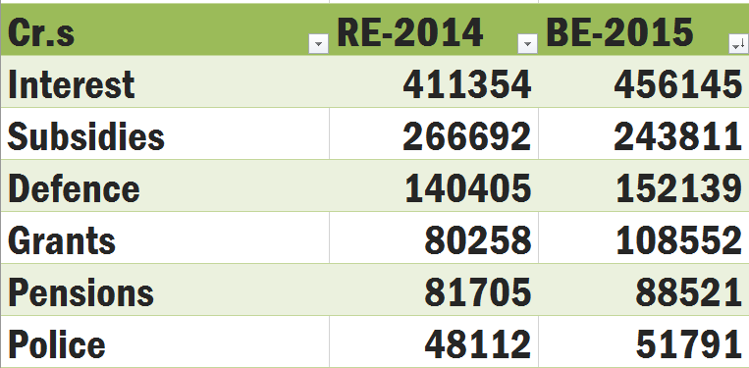
Revenue Expenditure
Internal?

Slide 106
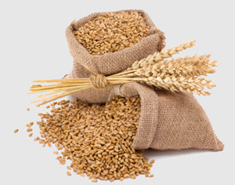

RE-2014 and BE-2015: Subsidies
Decreasing
Desi Urea
Decontrolled
Imported Urea

Slide 107
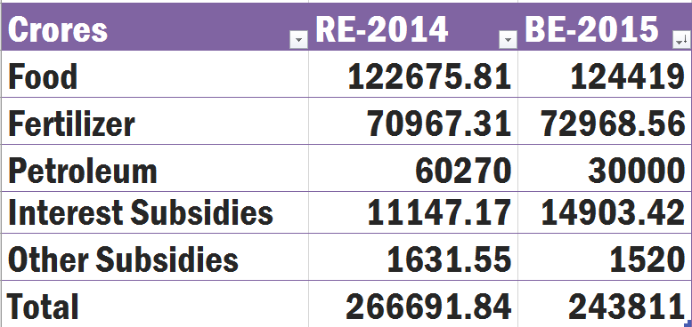
Highest decline: petroleum
decline
JAM trinity: in HRD, Agro lecture
Food 1.25 lakh| Total 2.5 lakh

Slide 108
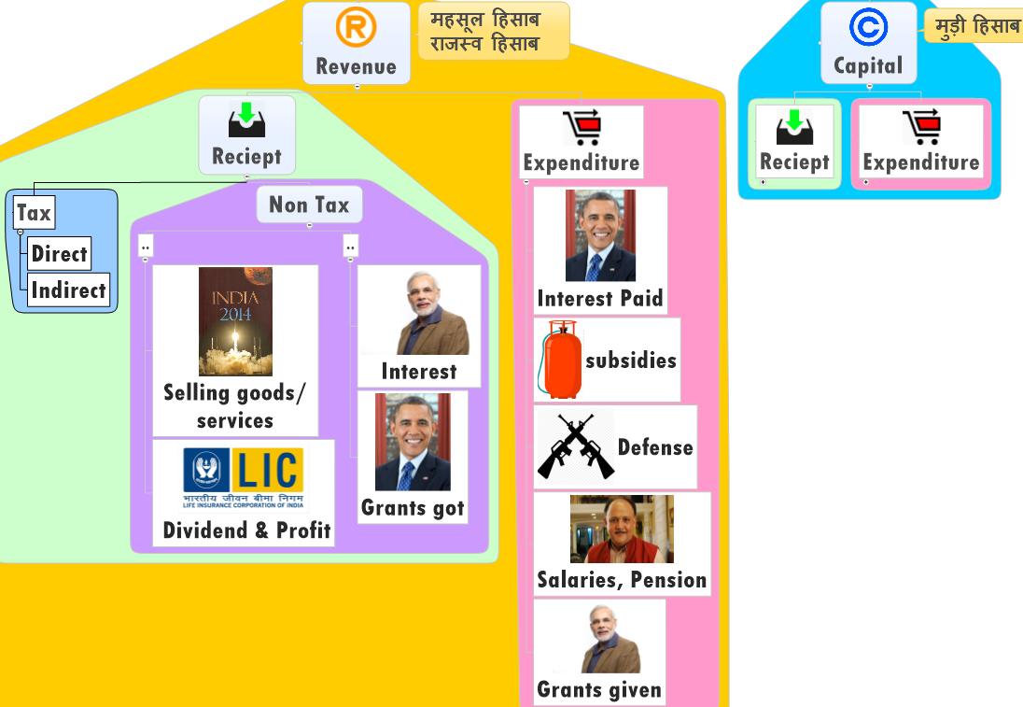
here

Slide 109
Revenue Expenditure મહેસુલ ખર્ચ
Interest, subsidies, grants, pension, defense
General election: >1500 Crores
Postal deficit: >6500 crores
Three organs, MEA, Tax collection
Social services: Health, edu, broadcast
Eco. Service: agriculture, power, postal, railways
UT with out Legislature

Slide 110
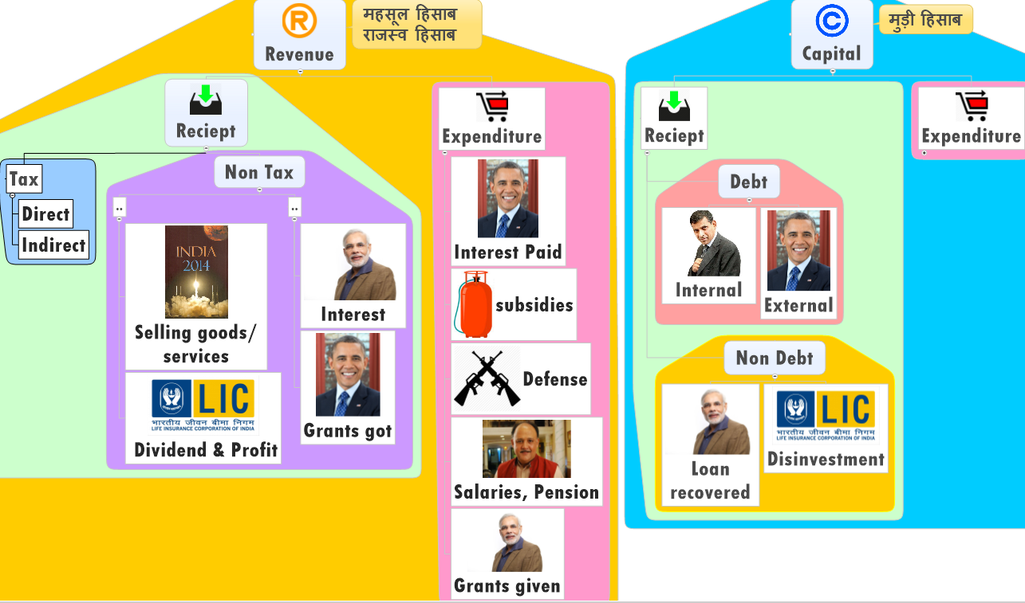
here

Slide 111
Capital Receipts
Debt (MORE)
Non-Debt (LESS)
Loans
Long vs Short
Internal vs Ext.
Provident Fund
Small savings
Disinvestment
Loan recovery (Principal)

Slide 112
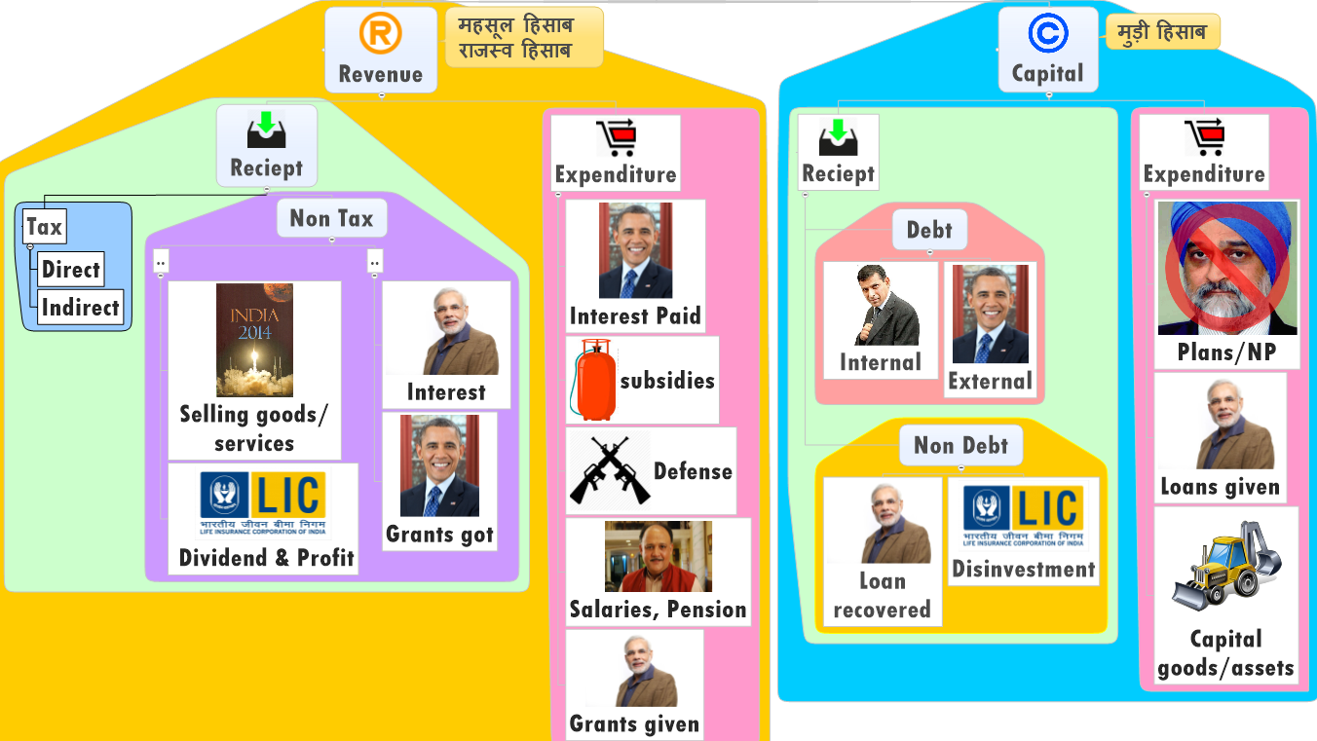

Slide 113
Capital Expenditure
Plan (LESS)
Non-plan (MORE)
Central Plan ▲
State plan ▼
UT plan ▲
Defense (95k)
Loans to PSU (11k)
Loans to Foreign (150)
Loans to State/UT (80)

Slide 114
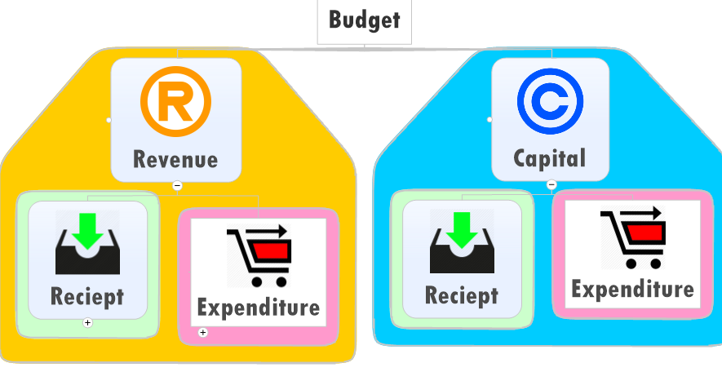
Where is plan/non plan/subsidies?

Slide 115
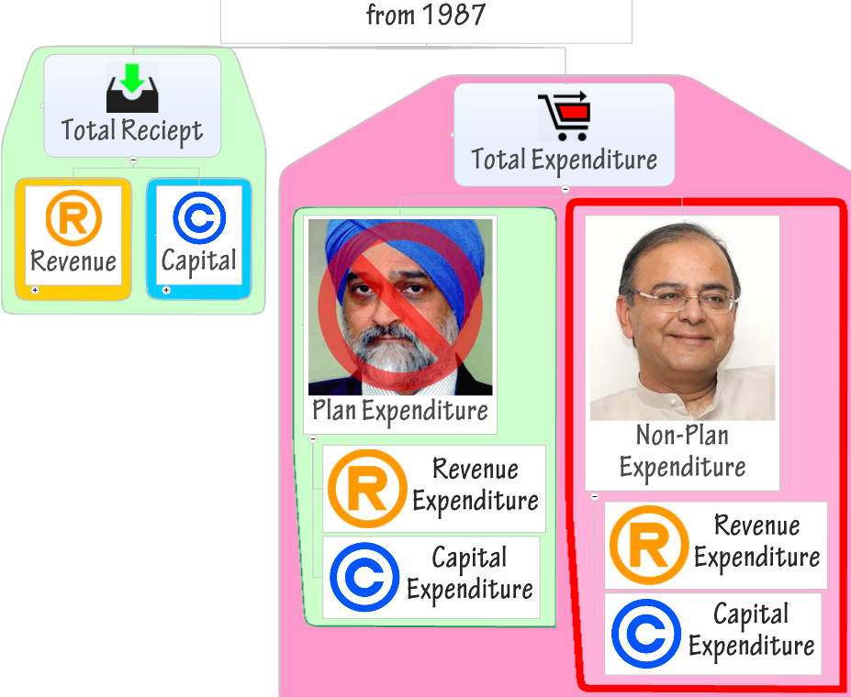

Slide 116
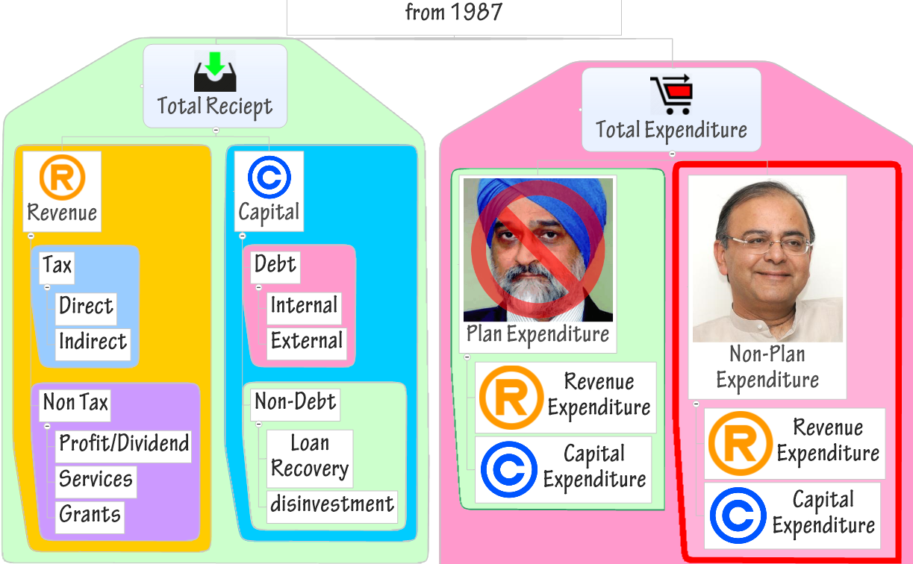

Slide 117
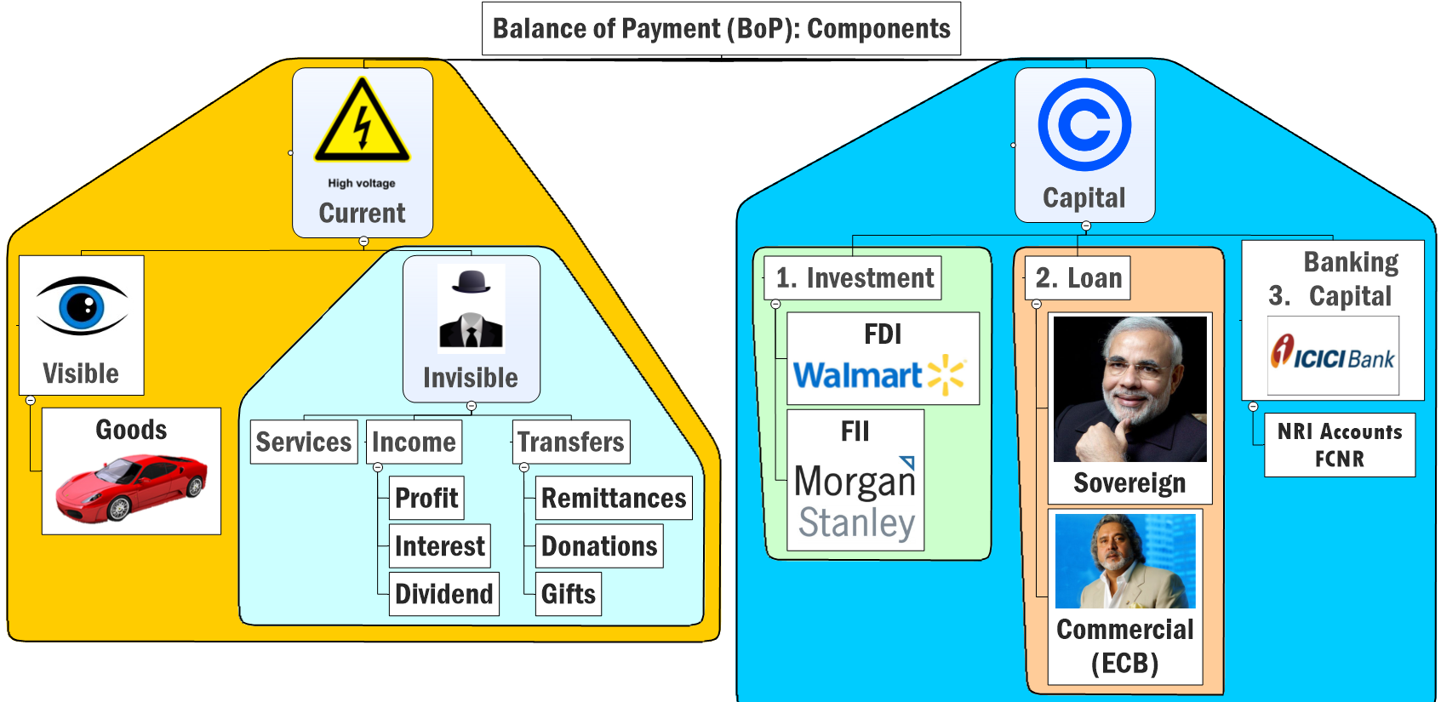

Current Account DEFICIT
Capital Account SURPLUS

Slide 119
Is it valid?
yes
Art.112: Budget (AFS) shall distinguish Expenditure on revenue part, from other Expenditures.

